Slide 1

Cold Email Generator
Umme Jannat Taposhi
A B M Muntasir Rahman Anindita Labonno Nahida Akter Tanjila
Group - 12

Slide 2
What is a Cold email?
A cold email is an unsolicited email sent to a recipient without prior contact or a pre-existing relationship

Slide 3




Problem Statement
.
Software Companies
Client Companies

Slide 4

Problem Statement
Software Companies
Client Companies

Slide 5
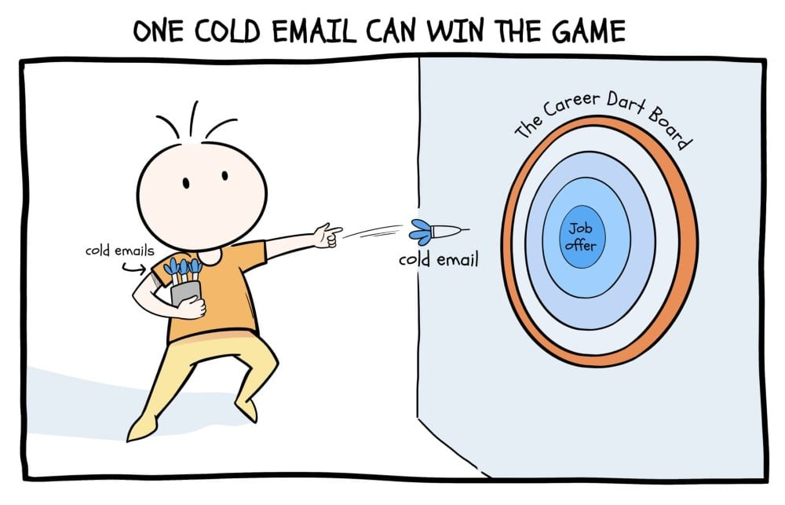
.

Slide 6

.

Slide 7
Technical Architecture and Workflow
Career Page / Job description
LLM (Llama 3.1)
Job = { ‘role’: ‘software engineer’, ‘experience’: [‘2 years experience in React’],
‘Description’: ‘We are looking for a….’
}
Chromadb
Cold Email
Portfolio Links
LLM (Llama 3.1)

Slide 8
Tools and Technologies
Language
Model
Data Storage and Retrieval
Computation Optimization
Llama 3.1
ChromaDB
GroqCloud
Data Extraction and Processing
User Interface Development
Programming Tools
Python
Prompt Templates
LangChain
Web B Loader
Streamlit
Notes:
First, we used Llama 3.1 as the core language model for generating personalized and professional cold emails. For efficient data storage and retrieval, we implemented ChromaDB, a vector database that allows semantic search and matching.
To handle data extraction from unstructured sources, we leveraged LangChain alongside Web B Loader for web scraping and processing job-related information.
For computation optimization, we integrated GroqCloud, which significantly reduced latency and ensured smooth performance during complex tasks.
On the front end, we used Streamlit to rapidly develop an intuitive and user-friendly interface.
Finally, Python served as our primary programming language and we used Custom Prompt Templates generating email content dynamically.

